Slide 1
CHAPTER- 10 (VECTOR ALGEBRA)
Content
Position Vector
Direction Cosines & Direction Ratios
Addition of Vectors
Components of Vectors
Vector Joining two points
Section Formula
Scalar and Vector Product
Angle between two Vectors

Slide 2
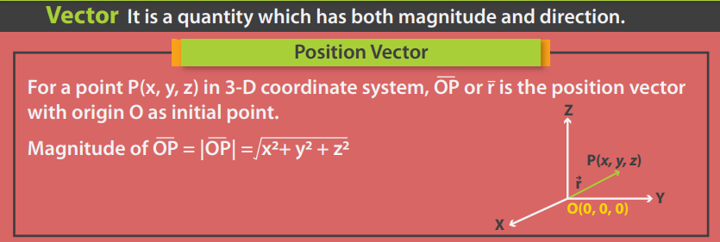

Slide 3
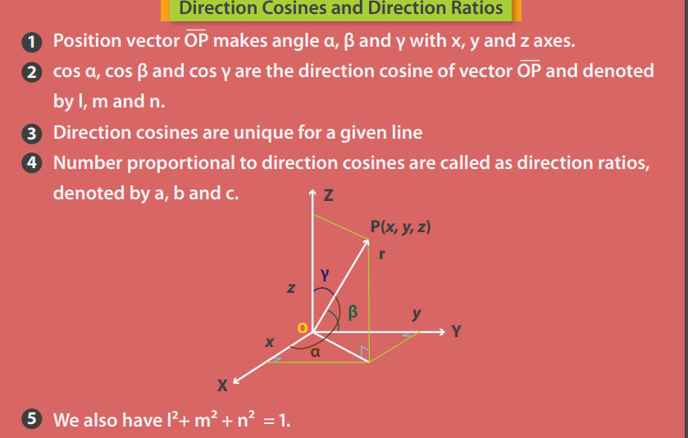
Any 3 numbers proportional to Direction Cosines are called Direction Ratios

Slide 4
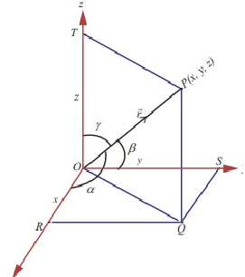
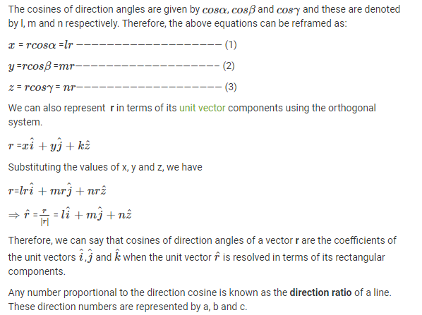

Slide 5
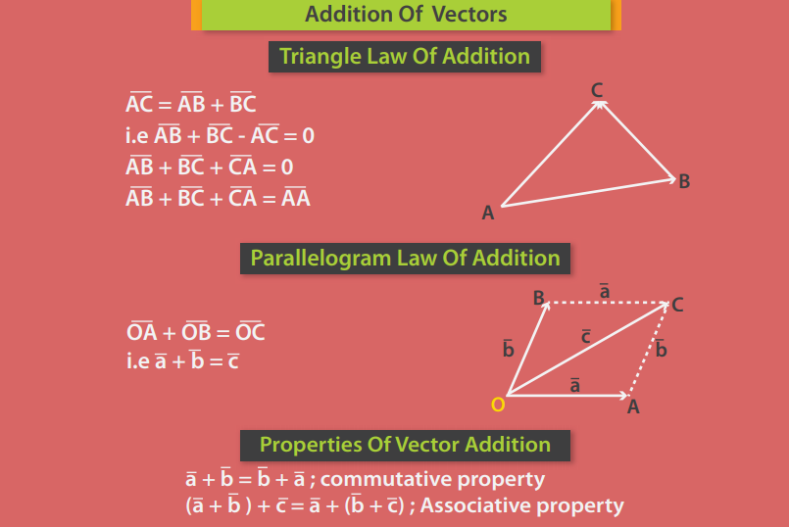
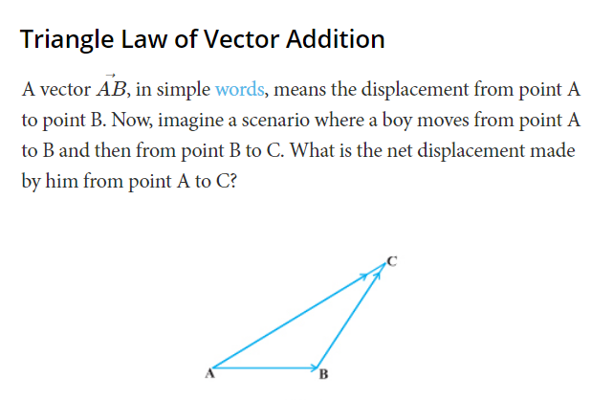

Slide 6
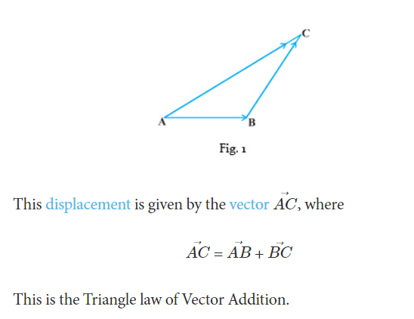

Slide 7
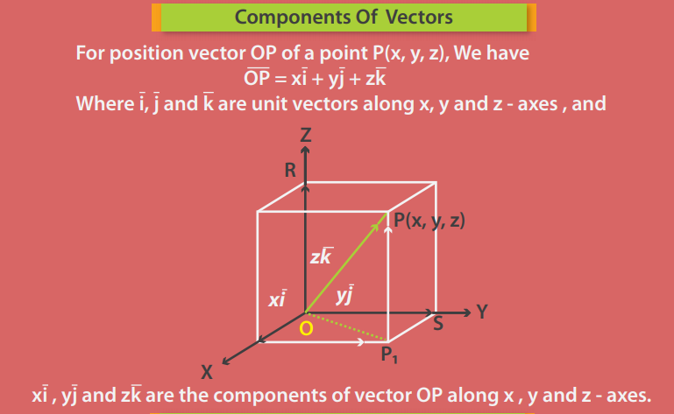

Slide 8
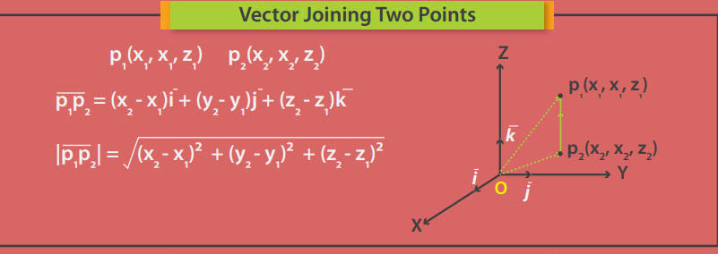

Slide 9
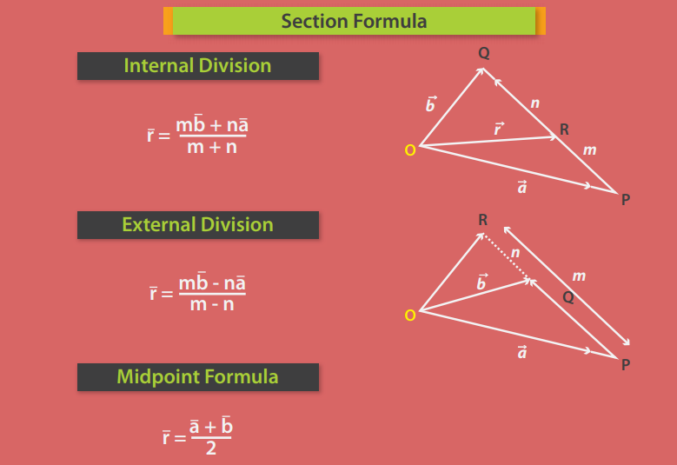

Slide 10
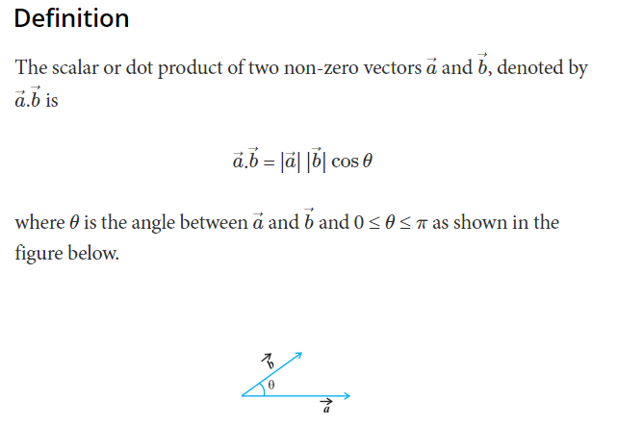
SCALAR OR DOT PRODUCT
It is important to note that if either a = or b = 0, then θ is not defined, and in this case dot product is 0

Slide 11
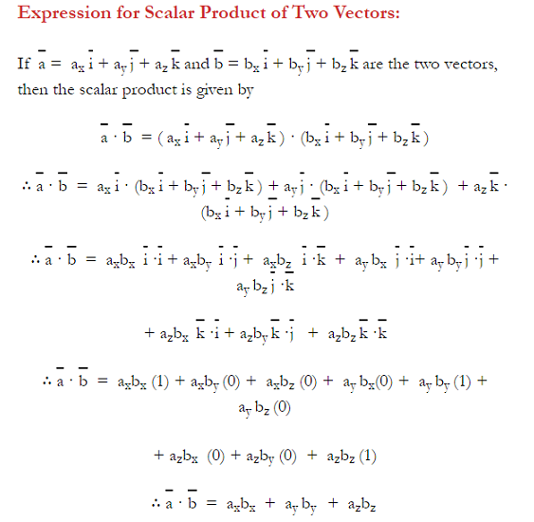

Slide 12
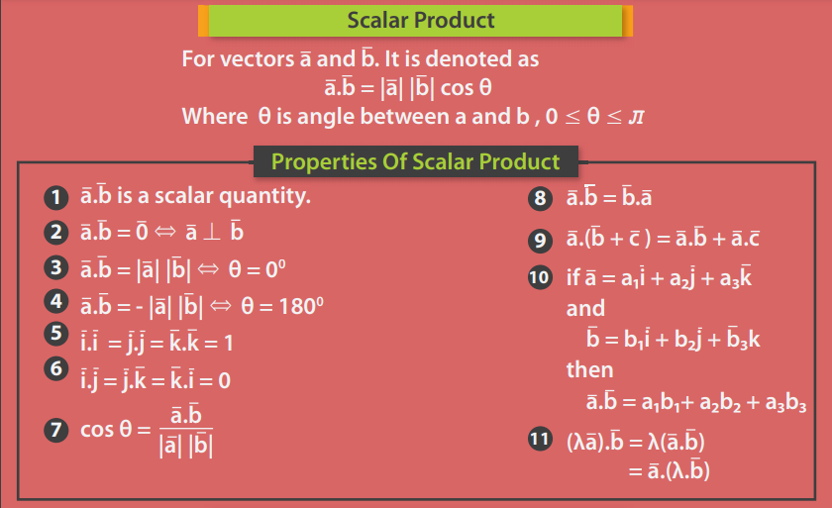

Slide 13
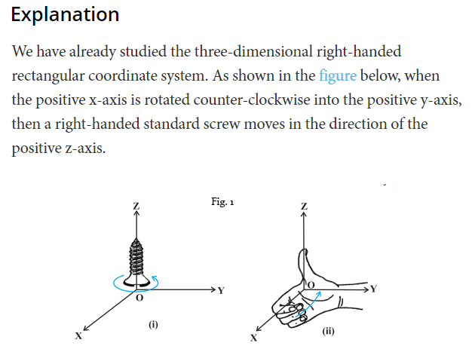
VECTOR OR CROSS PRODUCT
As can be seen here, in a three-dimensional right-handed rectangular coordinate system, the thumb of the right-hand points in the direction of the positive z-axis when the fingers are curled from the positive x-axis towards the positive y-axis.

Slide 14
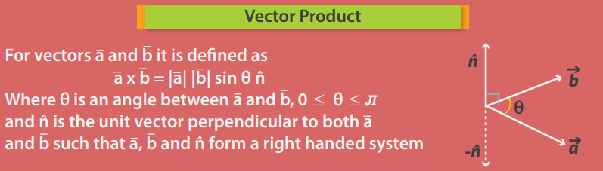
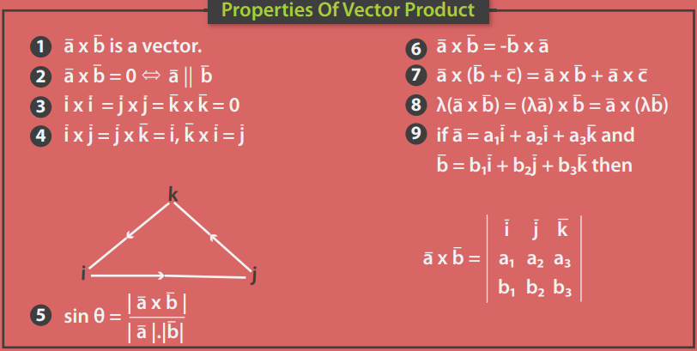

Slide 15
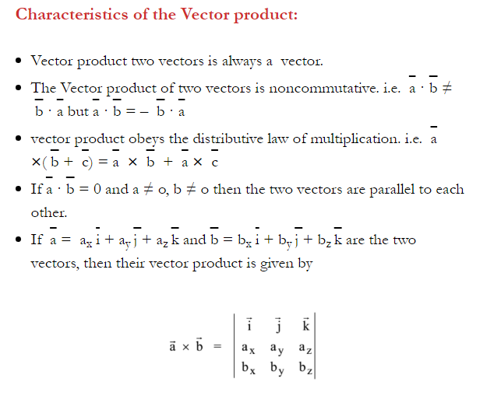

Slide 16
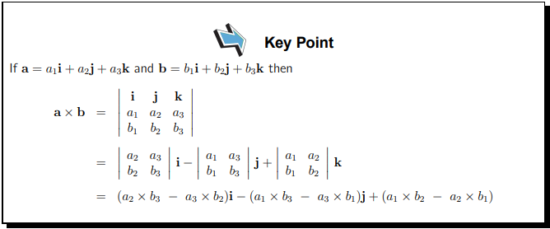
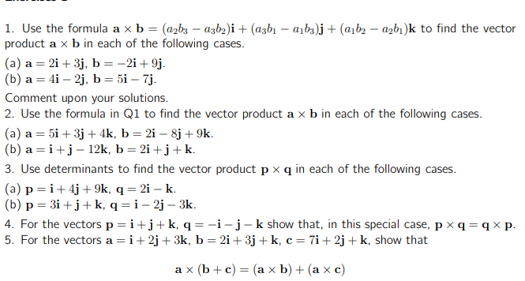
Try These

Slide 17
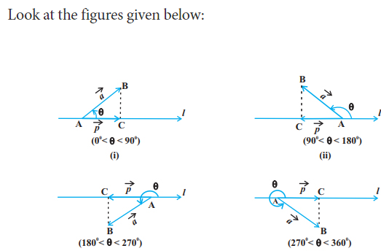
ANGLE BETWEEN TWO VECTORS
Angle between vectors p and a is always measured anti- clockwise from p to a .

Slide 18

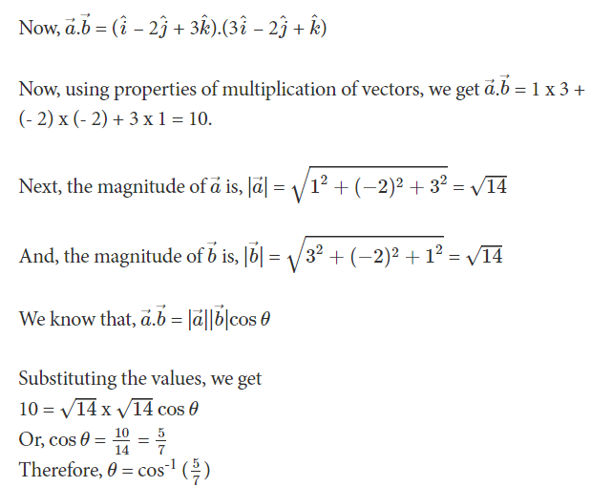
Solution

